Slide 1



Slide 2


Slide 3
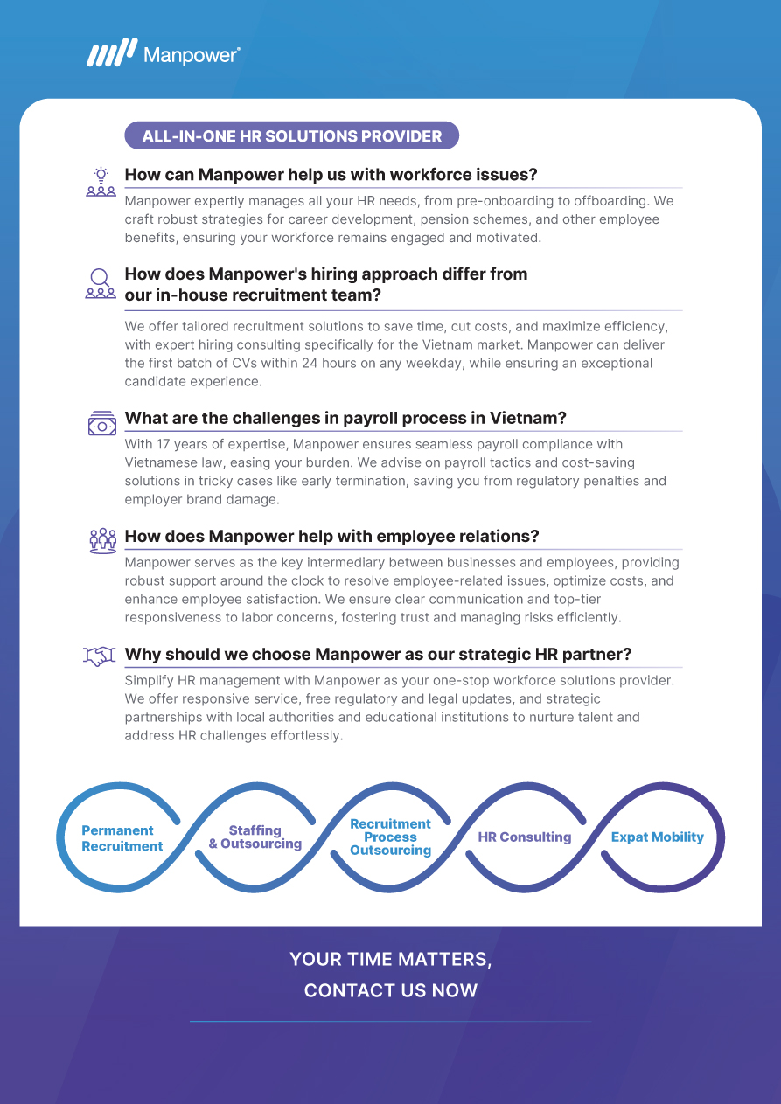



inquiry@manpower.com.vn

